Slide 1
The Impact of SB-482 on Benzodiazepine Prescribing in California A Synthetic Control Analysis
Alanoud Alturki

Slide 2
1. Key Question of the Study
Did the implementation of SB-482 in 2018 lead to a significant reduction in benzodiazepine prescribing in California compared to other states?

Slide 3
Background
SB-482 (2018): Mandates prescribers consult the state’s PDMP (CURES) before prescribing controlled substances.
Objective: reduce inappropriate prescribing and drug misuse.
Focus: Benzodiazepines.

Slide 4
Data Sources
Dataset: (2017–2022)
Source: CMS Medicare Part D Prescriber Public Use Files
Outcome Variable: claims_per_1000 (Benzo claims per 1,000 beneficiaries)
Treated Unit: California
Control Group: Synthetic California (weighted from other states)

Slide 5
Methodology – Synthetic Control
Constructed a synthetic control using other states with no similar policy.
Matched pre-policy trends (2017–2018).
Used Synth R package: dataprep() & synth() functions.
Visualized synthetic outcomes.

Slide 6
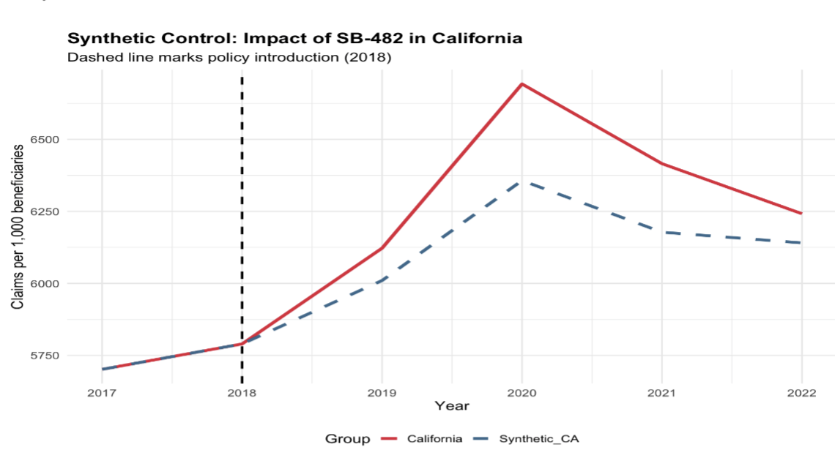
Results – Synthetic Control Plot
Pre-2018: Trends closely aligned.
Post-2018: California diverges—higher prescribing than synthetic control, especially in 2020.
2022: Both decline, California remains higher.

Slide 7
Interpretation
Initial Increase (2018–2020):
Lag in enforcement
Anxiety/pandemic effects
Prescriber non-compliance
Post-2020 Decline:
Delayed policy effect
Stronger PDMP integration
Broader external factors (federal guidelines)

Slide 8
Limitations
Only 2 years of pre-policy data (limits matching quality).
No adjustment for state-level confounders (COVID-19 severity).
No control for demographic or clinical variables.

Slide 9
Conclusion
SB-482 did not immediately reduce benzo prescribing.
A delayed reduction observed post-2020.
Future research should incorporate:
More data
Longer pre-policy trends

